Slide 1
Machine Learning With Python
Nabajyoti Pathak

Slide 2
What are Dimension Reduction techniques?
Dimension Reduction refers to the process of converting a set of data having vast dimensions into data with lesser dimensions ensuring that it conveys similar information concisely.
These techniques are typically used while solving machine learning problems to obtain better features for a classification or regression task.

Slide 3
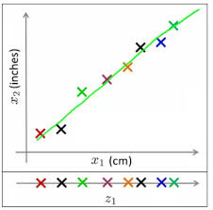
Example
It shows 2 dimensions x1 and x2, which are let us say measurements of several object in cm (x1) and inches (x2).
Now, if you were to use both these dimensions in machine learning, they will convey similar information and introduce a lot of noise in system, so you are better of just using one dimension.
Here we have converted the dimension of data from 2D (from x1 and x2) to 1D (z1), which has made the data relatively easier to explain.

Slide 4
Example
In similar ways, we can reduce n dimensions of data set to k dimensions (k < n) .
These k dimensions can be directly identified (filtered) or can be a combination of dimensions (weighted averages of dimensions) or new dimension(s) that represent existing multiple dimensions well.

Slide 5
What are the benefits of Dimension Reduction?
It helps in data compressing and reducing the storage space required
It fastens the time required for performing same computations. Less dimensions leads to less computing, also less dimensions can allow usage of algorithms unfit for a large number of dimensions
It takes care of multi-collinearity that improves the model performance. It removes redundant features. For example: there is no point in storing a value in two different units (meters and inches).
Reducing the dimensions of data to 2D or 3D may allow us to plot and visualize it precisely. You can then observe patterns more clearly. Below you can see that, how a 3D data is converted into 2D. First it has identified the 2D plane then represented the points on these two new axis z1 and z2

Slide 6
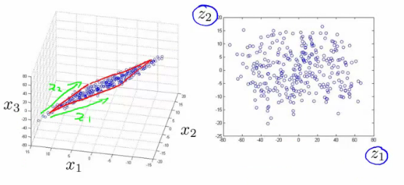
Example
It is helpful in noise removal also and as result of that we can improve the performance of models.

Slide 7
What are the common methods to perform Dimension Reduction?
Missing Values
Low Variance Filter
High Correlation filter
Random Forest
Forward Feature Selection
Principal Component Analysis (PCA)

Slide 8
Missing Value Ratio
While exploring the data, you find that your dataset has some missing values. Now what?
You will try to find out the reason for these missing values and then impute them or drop the variables entirely which have missing values (using appropriate methods).
What if we have too many missing values (say more than 50%)? Should we impute the missing values or drop the variable?
It would be preferred to drop the variable since it will not have much information.
However, this isn’t set in stone. We can set a threshold value and if the percentage of missing values in any variable is more than that threshold, we will drop the variable.

Slide 9
Low Variance Filter
Consider a variable in our dataset where all the observations have the same value, say 1. If we use this variable, do you think it can improve the model we will build? The answer is no, because this variable will have zero variance.
So, we need to calculate the variance of each variable we are given. Then drop the variables having low variance as compared to other variables in our dataset. The reason for doing this, as I mentioned above, is that variables with a low variance will not affect the target variable.

Slide 10
High Correlation filter
High correlation between two variables means they have similar trends and are likely to carry similar information.
This can bring down the performance of some models drastically (linear and logistic regression models, for instance).
We can calculate the correlation between independent numerical variables that are numerical in nature.
If the correlation coefficient crosses a certain threshold value, we can drop one of the variables (dropping a variable is highly subjective and should always be done keeping the domain in mind).

Slide 11
Random Forest
Random Forest is one of the most widely used algorithms for feature selection.
It comes packaged with in-built feature importance so you don’t need to program that separately.
This helps us select a smaller subset of features.

Slide 12
Backward Feature Elimination
Follow the below steps to understand and use the ‘Backward Feature Elimination’ technique
We first take all the n variables present in our dataset and train the model using them
We then calculate the performance of the model
Now, we compute the performance of the model after eliminating each variable (n times), i.e., we drop one variable every time and train the model on the remaining n-1 variables
We identify the variable whose removal has produced the smallest (or no) change in the performance of the model, and then drop that variable
Repeat this process until no variable can be dropped

Slide 13
Forward Feature Selection
This is the opposite process of the Backward Feature Elimination we saw above. Instead of eliminating features, we try to find the best features which improve the performance of the model. This technique works as follows:
We start with a single feature. Essentially, we train the model n number of times using each feature separately
The variable giving the best performance is selected as the starting variable
Then we repeat this process and add one variable at a time. The variable that produces the highest increase in performance is retained
We repeat this process until no significant improvement is seen in the model’s performance

Slide 14
Principal Component Analysis (PCA)
PCA is a technique which helps us in extracting a new set of variables from an existing large set of variables. These newly extracted variables are called Principal Components
A principal component is a linear combination of the original variables
Principal components are extracted in such a way that the first principal component explains maximum variance in the dataset
Second principal component tries to explain the remaining variance in the dataset and is uncorrelated to the first principal component
Third principal component tries to explain the variance which is not explained by the first two principal components and so on

Slide 15
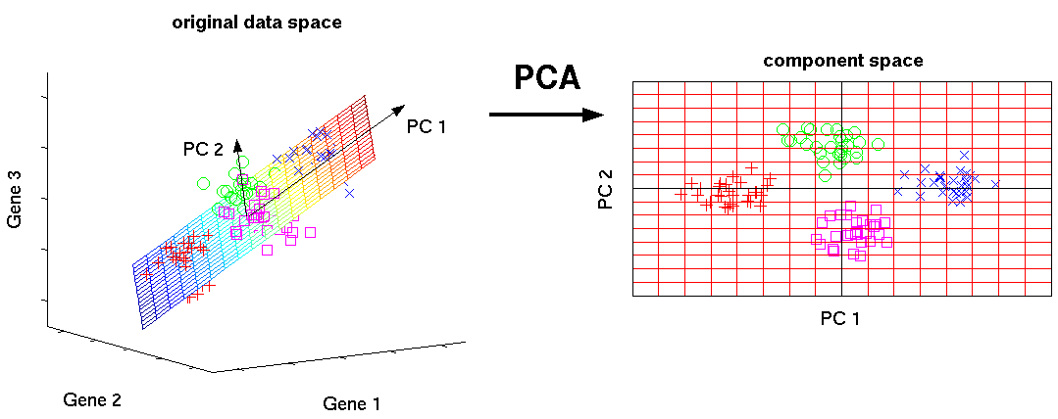

Slide 16
LDA(Linear Discriminate Analysis)
Finding linear combination of features/attributes which classify/separate two or more classes of objects
The combination is used as linear classifier which actually is through dimensionality reduction
Similar to PCA as it looks for linear combinations of variables to represent the data

Slide 17
LDA
PCA is data representation in reduced dimension space
In PCA, data is projected into directions of maximum variance
Direction of maximum variance might not be helpful for classification
LDA projects data in the direction that will be useful for classification

Slide 18
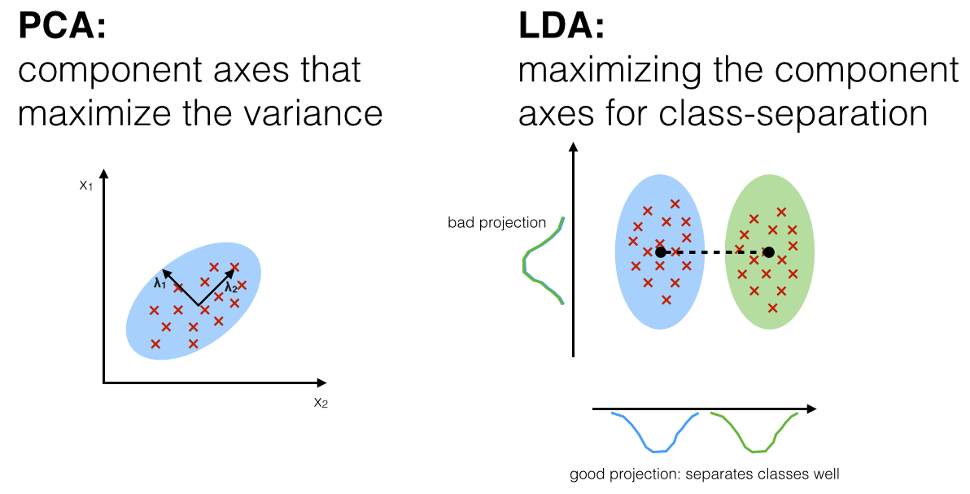
LDA vs PCA

Slide 19
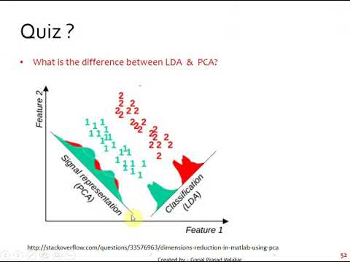
PCA VS LDA

Slide 20


